Slide 1
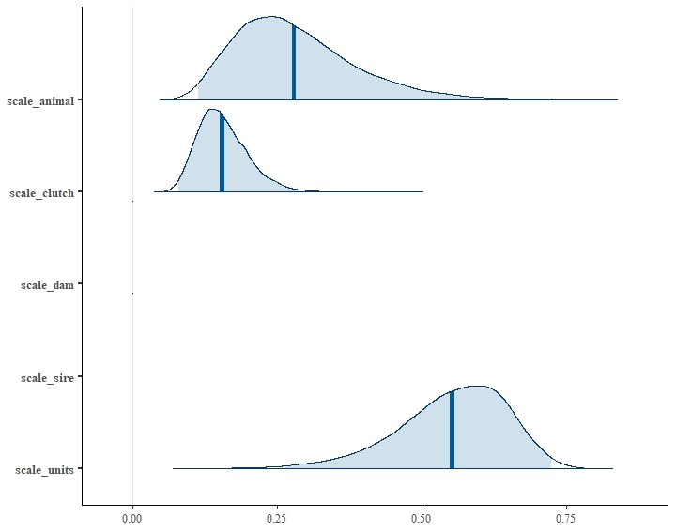
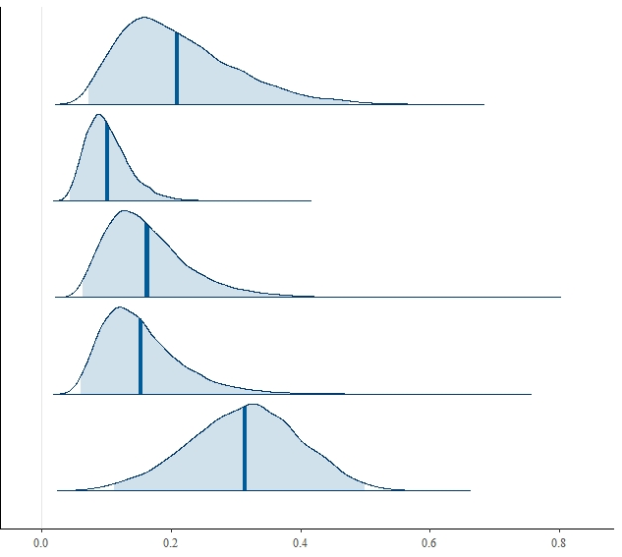
Standard Length
(a)
(b)
Additive genetic
Additive genetic
Clutch
Effect
Maternal
Paternal
Residual
0
0.25
0.5
0.75
0
0.25
0.5
0.75
Estimated proportion of variance
Notes:
W720xH567
Rescale to 4” tall

Slide 2
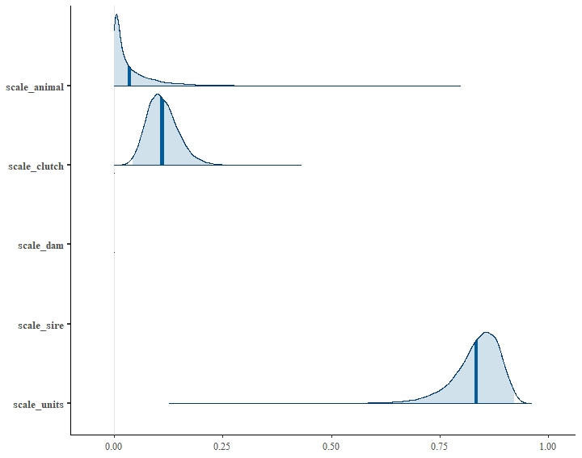
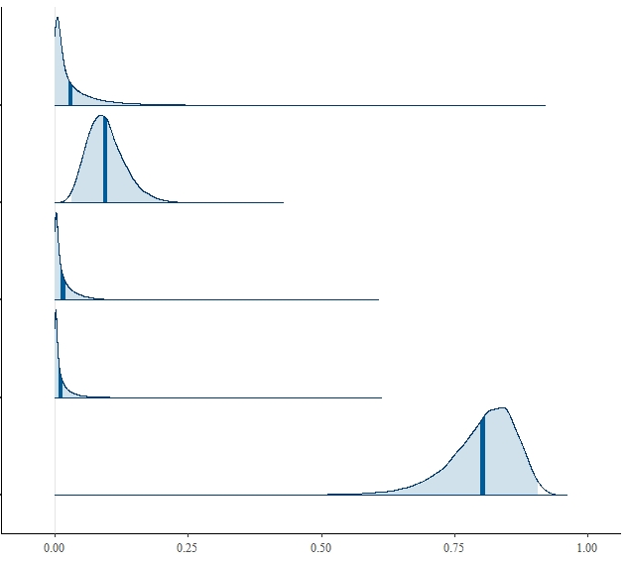
Ucrit
(a)
(b)
Additive genetic
Additive genetic
Clutch
Effect
Maternal
Paternal
Residual
0
0.25
0.5
0.75
1.0
0
0.25
0.5
0.75
1.0
Estimated proportion of variance
Notes:
W720xH567
Rescale to 4” tall

